Slide 1


SMART AI INTERVIEW PRATICE PROTAL USING AIPS
BATCH - 14
PRESENTED BY
PRADEEP K - 2403811724321075
SHANMUGA PRIYAN KS - 2403811724321105
VARSHA A - 2403811724322123
VIGNESH K - 2403811724321124

Slide 2

PRESENTATION OVERVIEW
Problem Statement
Objective
Literature Survey
Existing System
System Architecture
Proposed System
List of Modules
Modules Description
Conclusion

Slide 3
PROBLEM STATEMENT
Many students find it difficult to prepare effectively for technical and HR interviews. Traditional interview practice depends on mentors and fixed question sets, which provide limited personalization. Students lack instant and personalized feedback to understand and improve their interview performance.

Slide 4
OBJECTIVE
  Develop a smart interview practice portal for students. It conducts mock interviews with dynamic questions and evaluates the user’s responses. It provides instant scores, feedback, and suggestions to improve interview skills.

Slide 5
LITERATURE SURVEY
https://1drv.ms/x/c/bad771eb01b100f6/IQAqgQ67lTELSqgl7Gn-mtNCAUkTF8JpSNJ1xoJhQLokk8s?e=a6aq6S

Slide 6
EXISTING SYSTEM
Uses predefined interview questions.
Limited personalization for individual users.
No instant AI-based answer evaluation.
Feedback mainly depends on trainers.
Limited performance and progress tracking.

Slide 7
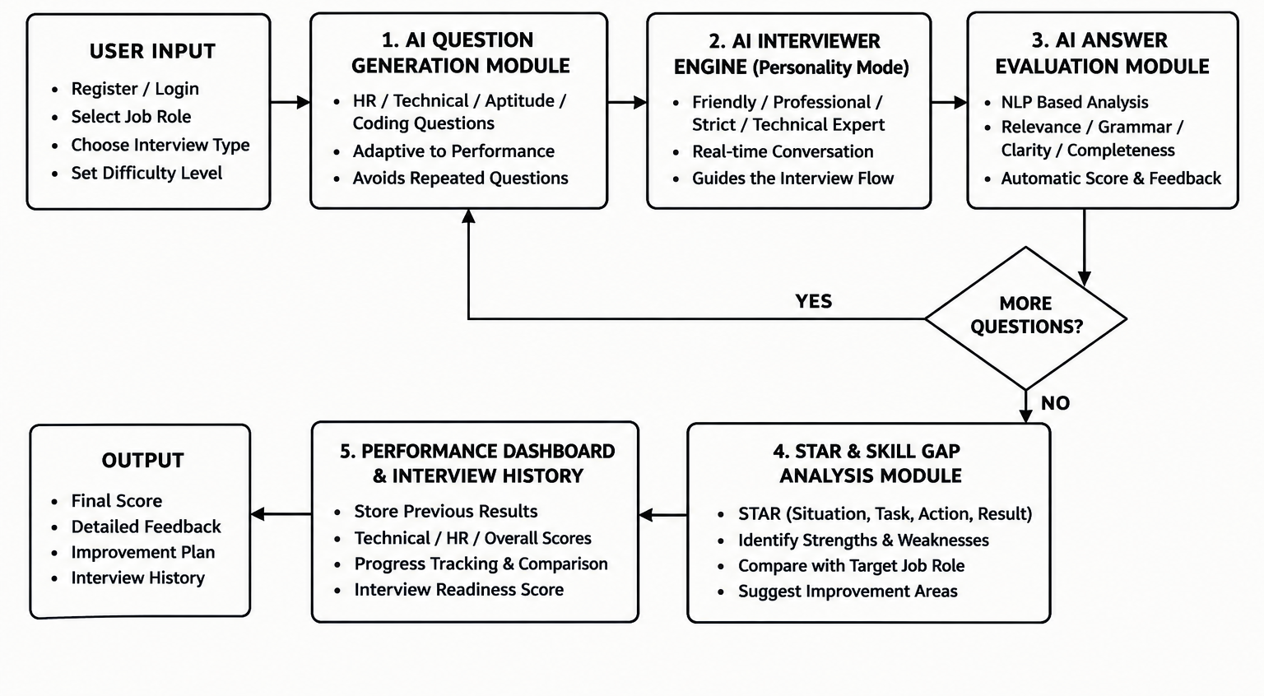
SYSTEM ARCHITECTURE

Slide 8
PROPOSED SYSTEM
Generates interview questions dynamically using AI.
Supports Technical, HR, Aptitude and Coding practice.
Evaluates answers using AI/NLP techniques.
Provides instant feedback and improvement suggestions.
Maintains interview history for tracking progress

Slide 9
LIST OF MODULES
Question Generation Module
Answer Evaluation Module
AI Follow-up & Adaptive Interview Module
STAR & Skill Gap Analysis Module
Performance Dashboard & Interview History Module

Slide 10
MODULE DESCRIPTION
Question Generation Module:
Generates questions based on the selected interview type.
Covers HR, Technical, Aptitude and Coding areas.
Adjusts question difficulty based on performance.

Slide 11
MODULE DESCRIPTION
Answer Evaluation (AI/NLP) Module :
Analyzes user responses using NLP.
Checks relevance, grammar, and confidence.
Provides suggestions to improve future performance.

Slide 12
MODULE DESCRIPTION
AI Follow-up & Adaptive Interview Module:
Generates follow-up questions from the previous answer.
Changes the difficulty according to user performance.
Provides a realistic interview experience.

Slide 13
MODULE DESCRIPTION
STAR & Skill Gap Analysis Module:
Analyzes answers using the STAR method.
Identifies the user's strengths and weak areas.
Suggests areas for further improvement

Slide 14
MODULE DESCRIPTION
Performance Dashboard & Interview History Module:
Stores previous interview results.
Displays scores and performance details.
Shows overall interview readiness and feedback.

Slide 15
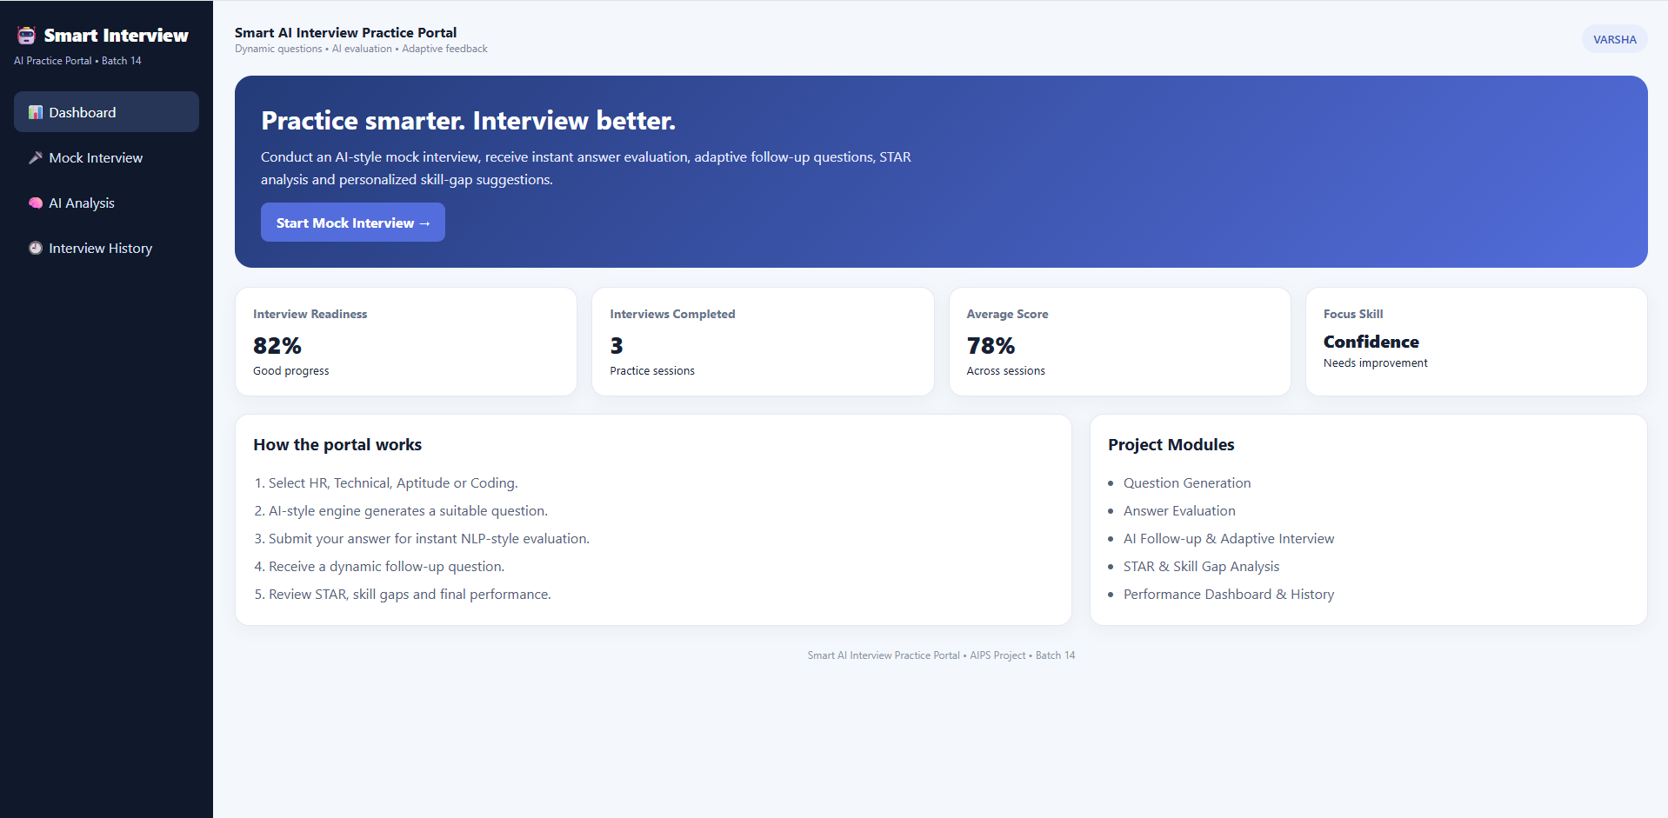
IMPLEMENTATION SCREENSHOT

Slide 16
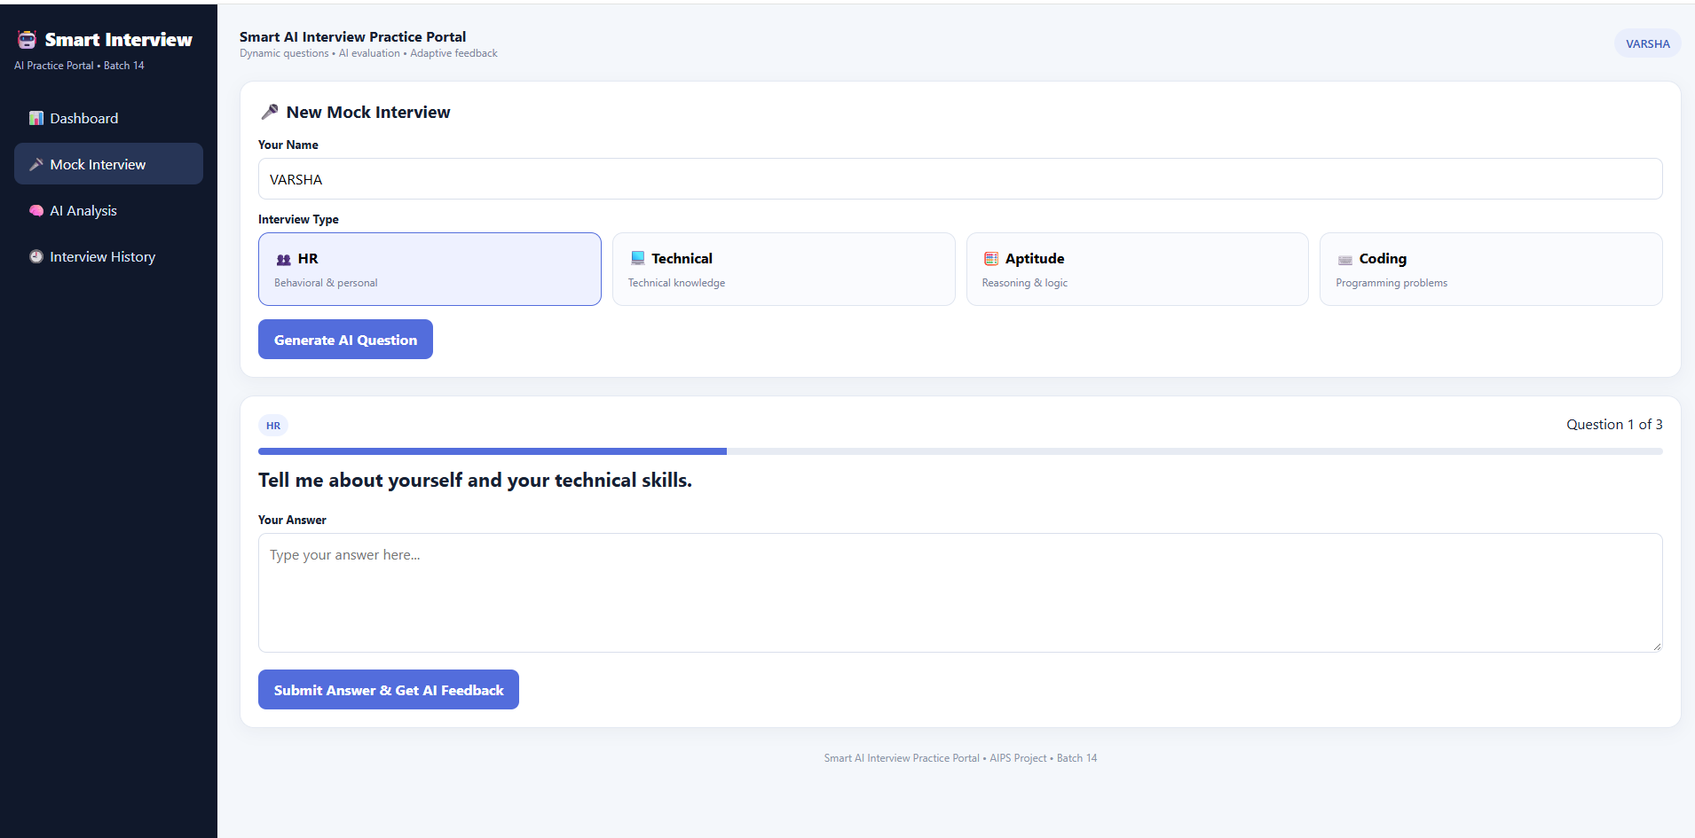
IMPLEMENTATION SCREENSHOT

Slide 17
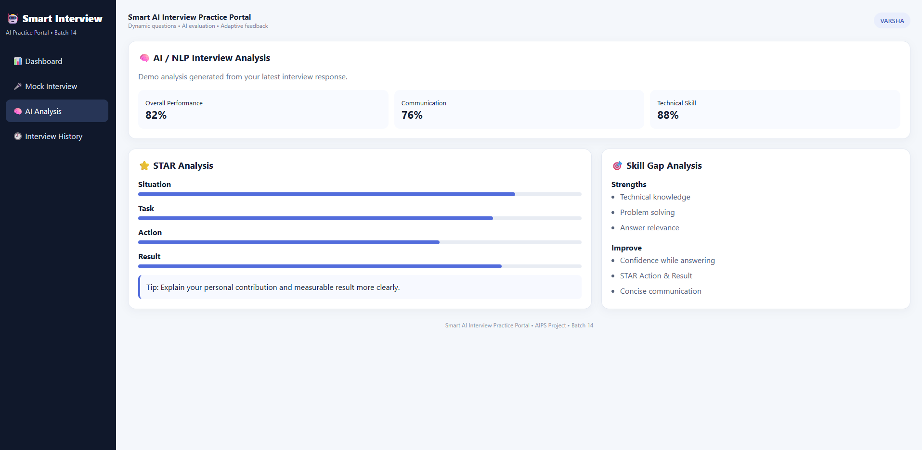
IMPLEMENTATION SCREENSHOT

Slide 18
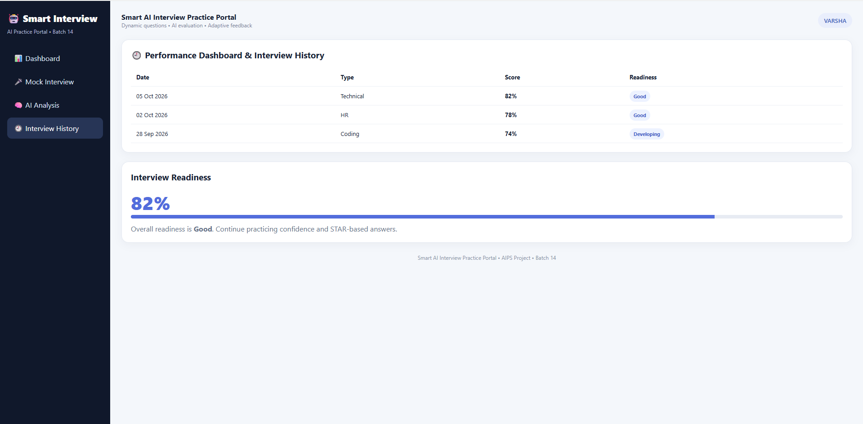
IMPLEMENTATION SCREENSHOT

Slide 19
CONCULSION
The Smart AI Interview Practice Portal provides an intelligent and personalized platform for interview preparation. It evaluates answers, provides instant feedback, identifies skill gaps, and tracks performance. Overall, it helps students improve their confidence, communication, technical skills, and interview readiness.

Slide 20
THANK YOU !!!

